Slide 1
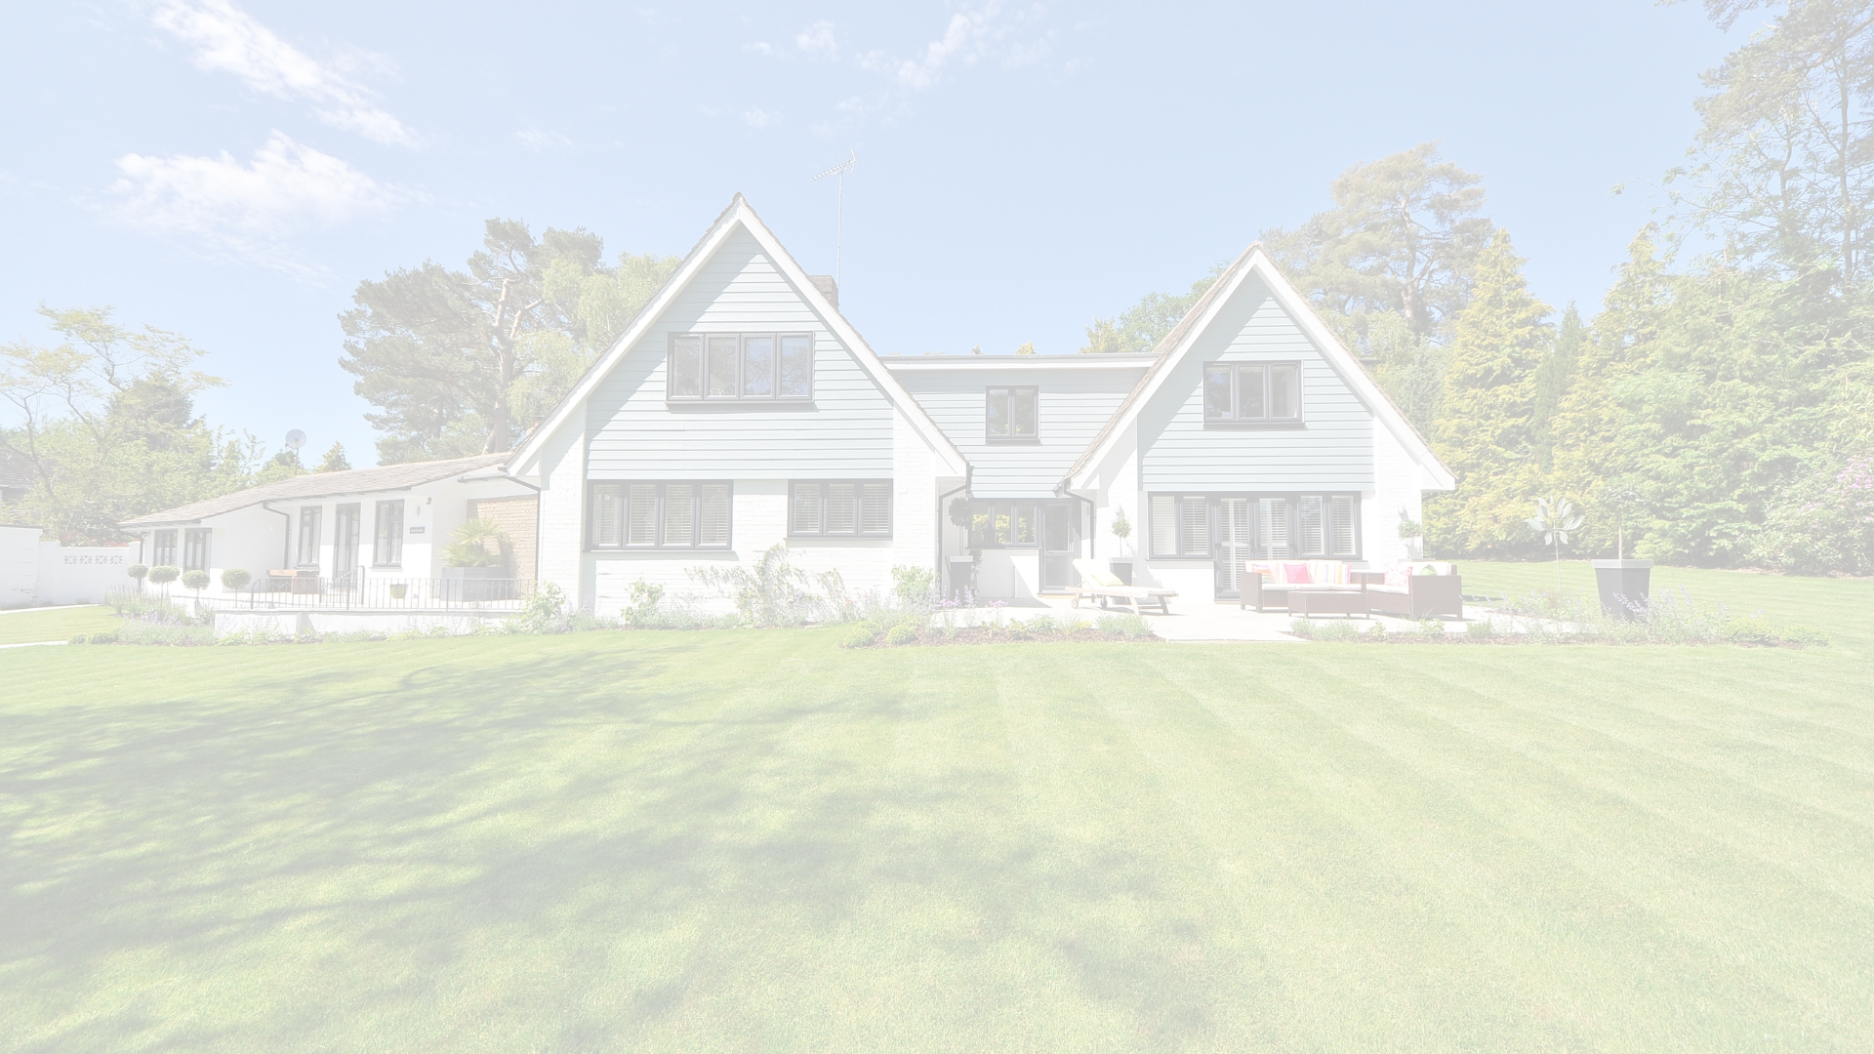

Bangladesh Army University of Engineering and Technology (BAUET)
Department of Computer Science and Engineering (CSE)
Course tittle: Software Development for Web Apps Sessional
Course Code: CSE–4106
Project name: Meta-Estate
Submitted by:
Sakib Raihan (18204009)
Md. Shah Abrar Zahin (18204021)
MD. Touhid Iqbal Sagar (18204023)
Md. Abdullah Al Fahad (18204025)
Mst. Rukhtaj Ara Choitee (18204031)
Submitted to:
Md. Omar Faruq
Lecturer, Department of CSE, BAUET
Md. Nazmus Salehin
Lecturer, Department of CSE, BAUET
Mst. Irin Sultana
Lecturer, Department of CSE, BAUET

Slide 2
Explanation of some existing system:
Web 3D is a term used to describe interactive 3D content included in an HTML page, viewable by a common Web browser via a special 3D viewer. It uses the concept of Web 3D also indicate a possible evolution of the Web where the idea was abandoned page.
We have an existing system called the next gallery (https://www.thenext.gallery/). This represents a photo gallery in a 3D web view. But in our web app, we have a 3D house design where user can experience the whole house in 3D using any browser.
Our proposed project is “Meta-Estate” - A 3D based home selling web application. It’s a new generation of web where we want to introduce it with the world. Though there are some architectural, environmental designing website exists from 2007 but we have implemented this technology for the first time in web platform. Where we are able to see 3D architectural view of a real environment in any type of web browser.

Slide 3
Scope of our works:
Using this platform any customer can find houses that fit perfect for him
We are using the b2b and b2c models so that users can easily complete their house-related deals here.
We are creating a 3D environment that can change the era of web technology.
By using this platform it's possible to experience the house in 3D view in real-time.

Slide 4
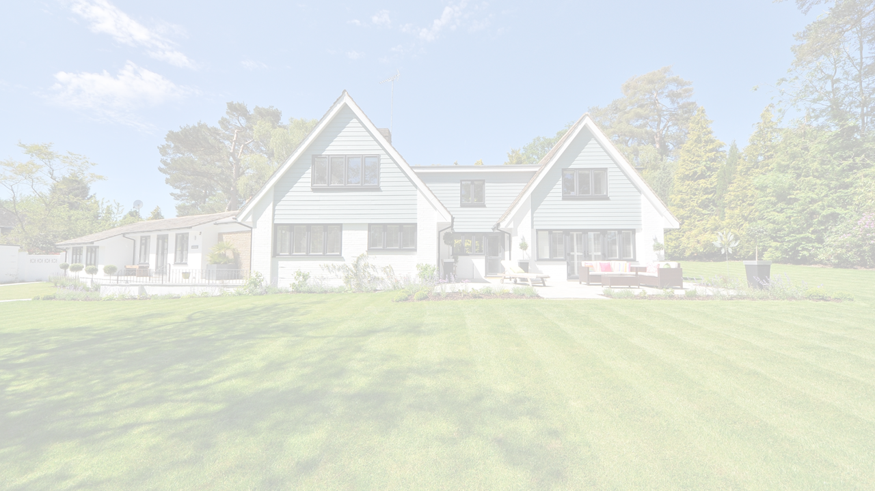
Methodology:
Step 1: User have to enter Meta-Estate from any browser.
Step 2: Then user have to sign up.
Step 3: Sign up process includes Gmail or Facebook account verification.
Step 4: The next web page contains some sample images of 3D houses and properties.
Step 5: Seller have options to send us blueprints or files.
Step 6: User can either chose the “BUY” option or “3D view” option.
Step 7: The 3D view option will show the 3D render view of any house or property.
Step 8: “BUY” option will be used for placing user’s order.
Step 9: User can Log Out after completing his task.

Slide 5
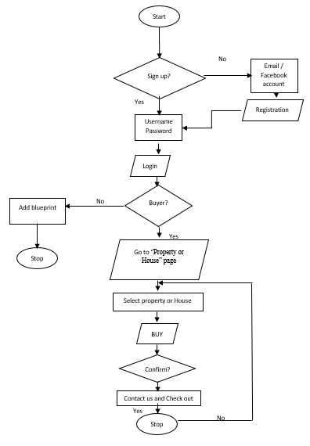
Flowchart:
Figure 01: Flowchart of Meta-Estate

Slide 6
Entity Relation (ER) Diagram
Meta-State website
Full name
Client
Choose
Property
Number of bathroom
Email id
Number of bedroom
Phone number
3D view
Price
Password
Confirm password
Figure 02: Entity Relation (ER) Diagram of Meta-Estate

Slide 7
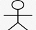
Use-case Diagram
System Boundary
Log in
View Apartment
View Outdoor Environment
View Plot
Admin
Customer
Contact us
Live chat for booking
Figure 02: Use–case Diagram of Meta-Estate

Slide 8
Requirements of your proposed models for the development:
(I)Software:
1.XAMPP
2.Notepad++
3.VS code
4.Sublime text
5.Blender
6.Unreal Engine
(II)Programming Language:
1. HTML
2.CSS
3.Java Script
4.PHP

Slide 9
Discussion:
Advantages:
i) Time saving.
ii) Cost effective.
iii) Convenience.
iv) No advertisement.
v) Multiple varieties.
vi) Accuracy.
vii) Easy price comparison
Disadvantages:
i) Page loading time.
ii) Time complexity.

Slide 10
Thank You

